Slide 1
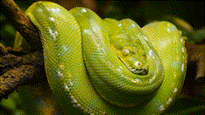
Python Fundamentals
Innovation Masters
Day 13

Slide 2
Today’s Agenda
Greetings and catching up
For loop review
Practice and review: start by making a program that uses lists
Introduction to objects
Tech Talk (a very special topic today)

Slide 3
Profile maker for CIA
Lists
Use lists to store different information about a person
Info
Name, age, nationality
Separate
Have a separate list for each type of information
Ask
Ask user how many profiles he wants to make
Store
Store the information in each list
Print out
Finally print out the profiles nicely

Slide 4
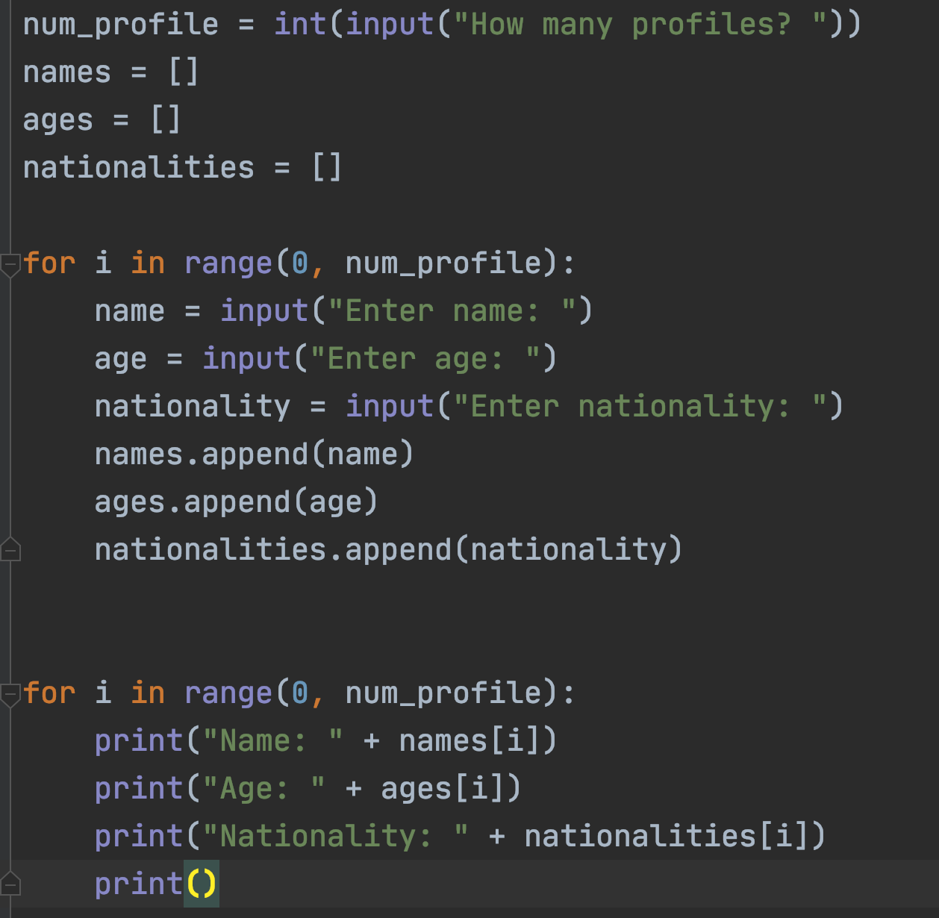
Solution

Slide 5
How to retrieve information?
Now let’s try to retrieve information for a specific person
We can use their name to get all the other information
Ask the user for a name
Display all the relevant information regarding that person

Slide 6
Was there a better way to do this?
Yes there is!
We can make objects to store name, age, and nationality bunched together.
An object can have different variables.
You can think of an object as a bigger variable that holds smaller variables.

Slide 7
Conceptualizing an object
Person
Name
Age
Nationality

Slide 8

Objects
An object can have one variable (usually more than one), or many variables, and it can also store other objects
So in short, an object is simply a cluster of variable that represent something bigger

Slide 9

Some object examples
Game: All the characters are objects. The different objects have different characteristic.
For ex: main character variables - position, speed, name,
For a tree – position, color, shape
Animal: name, speed, color, jump height, diet
Car: Brand, horsepower, energy type, color
These are just some examples. We can make an object with any variable(s) depending on what our program needs.

Slide 10
Object is the instance of a class
Definition of person
Name
Age
Nationality
Rifat Alam
22
Bengali
Person 1
Aaron Golf
36
Polish
Person 2

Slide 11

Tech Talk
Mind Upload - Kurzesagt

